Slide 1



Title: Advanced Trivia Quiz App using Python Tkinter and Open Trivia API

Slide 2
Project Description :
This Quiz App is a desktop application built using Python’s Tkinter library. It fetches trivia categories and multiple-choice questions from the Open Trivia Database API. Users can select a category, choose the number of questions, and take the quiz with a timer-based interface.
Each question is displayed with shuffled options, and users can navigate between questions. A countdown timer with sound alerts enhances the experience. Upon submission, the app calculates the score and exports results (category, correct answers, percentage) to a CSV file. The interface is styled with a dark theme, and the app ensures interactive learning with performance tracking.

Slide 3



Technologies & Tools Used
Component | Technology / Library | Purpose
GUI Framework | Tkinter | For building the desktop user interface
API Communication | requests | To fetch trivia categories and questions from API
Data Format Handling | base64 | Decoding API response (encoded in base64)
Randomization | random | Shuffling answer options
Data Storage | csv | Exporting quiz results to a CSV file
Sound Effects | winsound (Windows only) | Beep alerts for timer countdown
Data Parsing & Storage | json | Parsing API responses
Core Language | Python | Primary language for logic, control, and flow
External API | Open Trivia DB | Source of quiz questions and categories
OS Interaction | os | Checking file existence for result exports

Slide 4
Challenge | Description
API Encoding | Questions and answers are base64-encoded, requiring proper decoding.
Question Randomization | Ensuring correct answers are shuffled randomly without losing tracking.
Timer Management | Implementing countdown with after() and cancelling timers on navigation.
Sound Integration | Using winsound for beeps, which only works on Windows; cross-platform issues.
UI Navigation | Handling previous/next logic while saving user-selected options correctly.
Error Handling for API Failures | Managing cases where the API doesn't return enough questions or fails.
CSV Export Reliability | Ensuring data is appended without overwriting or corruption.
Responsive Layout in Tkinter | Designing a clean and readable interface across different resolutions.
Challenges Faced

Slide 5
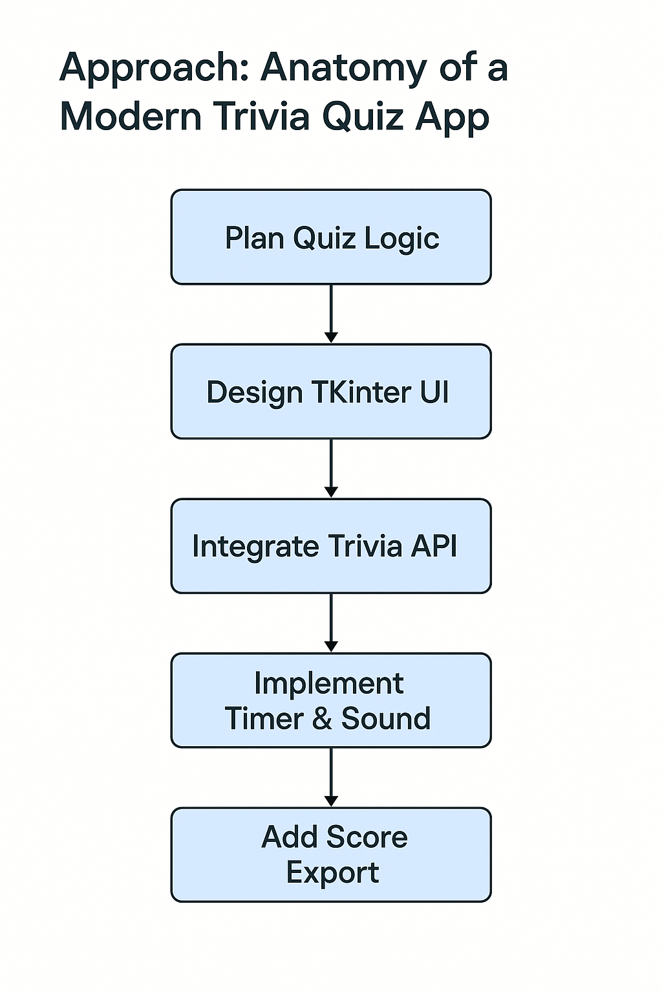
FLOWCHART

Slide 6
Project Approach – Quiz App (Tkinter + API Based)
The project follows a modular and event-driven approach. Here’s the step-by-step strategy used:
1.Requirement Analysis
Build a quiz app with categories, timer, score calculation, sound, and result export.
2.Technology Stack Selection
Python with Tkinter for GUI, requests for API, winsound for alerts, and csv for result logging.
3.API Integration
Use Open Trivia Database (opentdb.com) to fetch dynamic categories and questions.
4.UI Design (Tkinter)
Build selection screen → quiz interface → result submission screen with navigation buttons.
5.Core Logic
Handle base64 decoding, question shuffling, timer (after()), sound alerts, and scoring.
6.Data Handling
Store user answers, calculate score, and export to score.csv.
7.Testing & Edge Handling
Handle API failure, invalid inputs, and no-question scenarios gracefully.

Slide 7
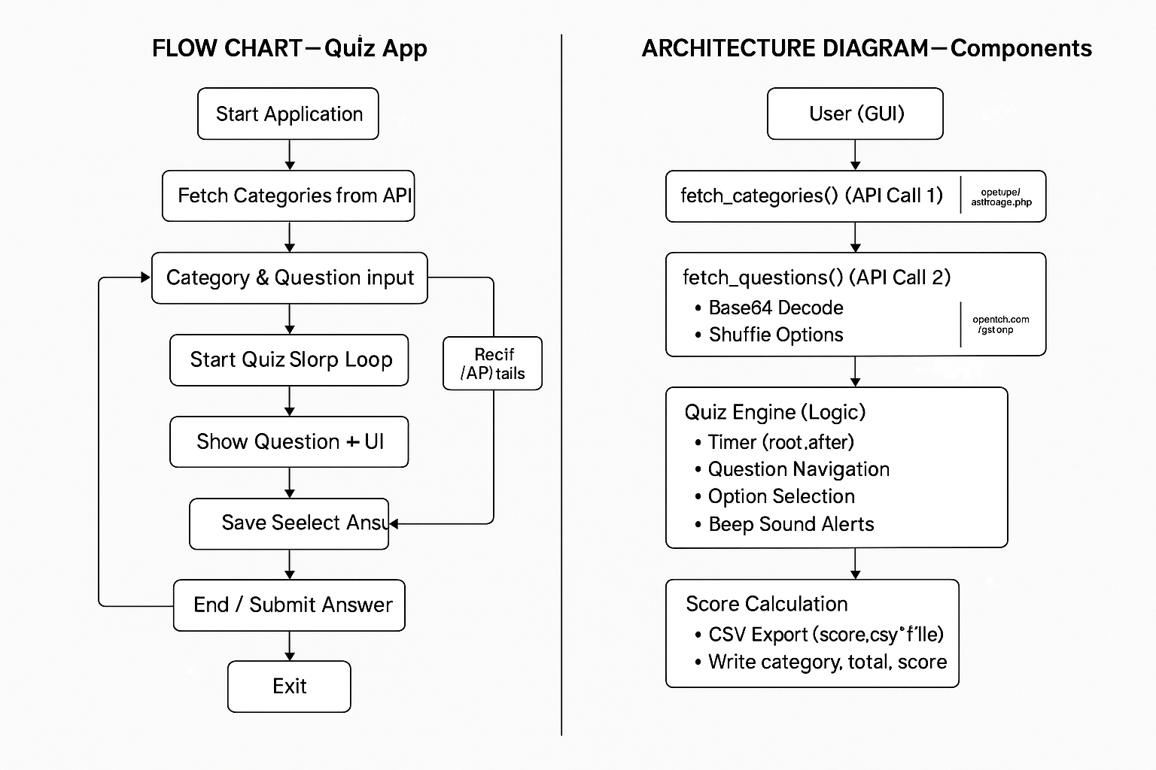

Slide 8
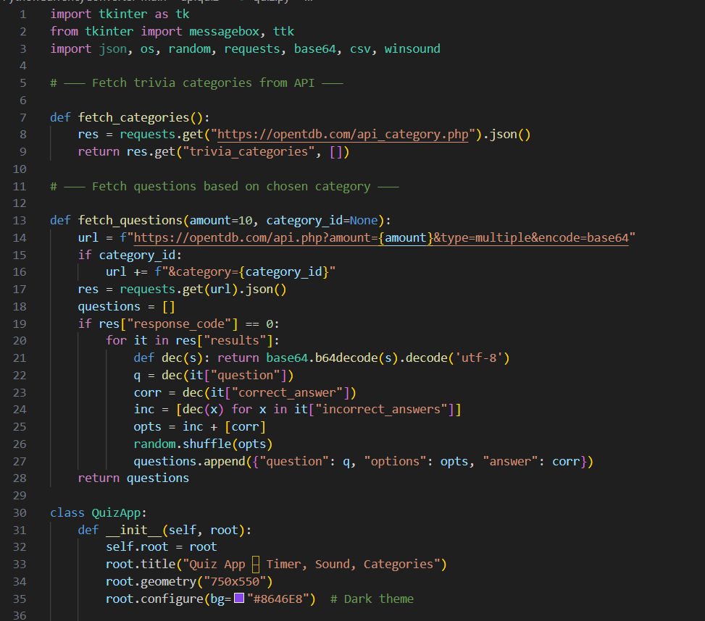
CODES

Slide 9
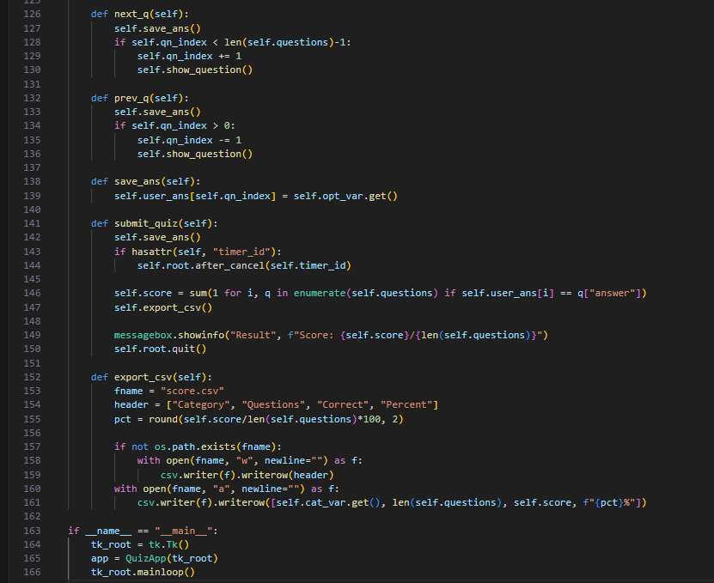

Slide 10
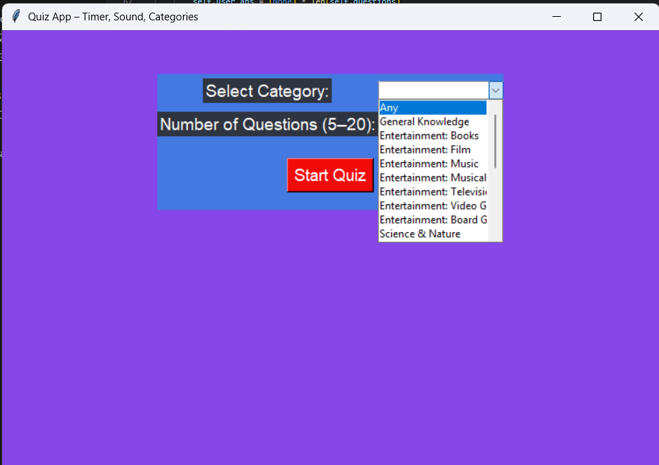
OUTPUT:

Slide 11
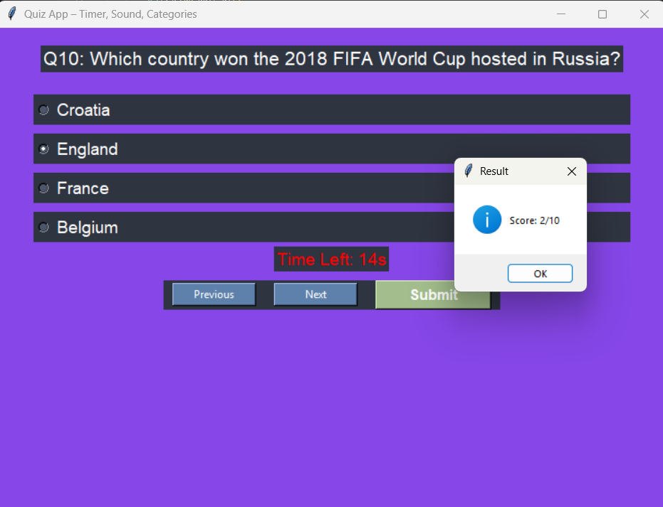

Slide 12
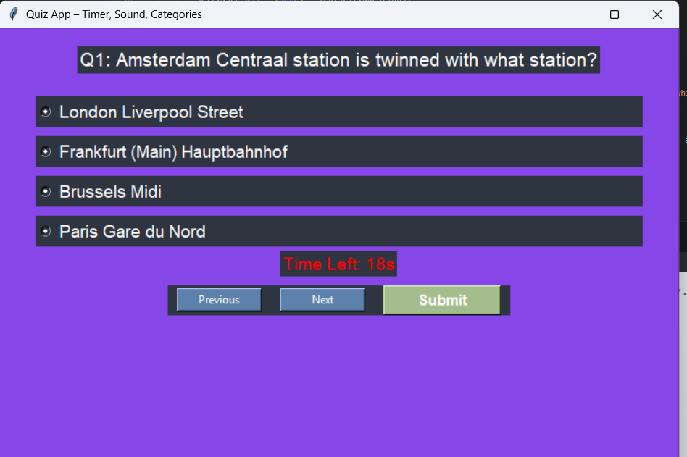

Slide 13

Title: Advanced Trivia Quiz App using Python Tkinter and Open Trivia API
SUBMITTED BY: JATIN KUMAR
SUBMITTED TO TAMIZHAN SKILLS

